Slide 1


Software Defined Availability
– x86 Fault Tolerant 이중화 솔루션
2014-04-03

Slide 2









변화하는 인프라 환경의 요구
24/7/365
Self-service online
자동화 시스템의 대량 확산
모바일 환경의 신뢰성 향상
상호작용 서비스의 증가
Cloud ► ► ► ►
Datacenters/Virtualization ► ►
More Industries
More Users
More Virtual Servers
More Critical Applications
More Industries
More Users
More Virtual Servers
More Critical Applications
Mainframes ► x86 Servers ► ►
Notes:
Stratus has been supporting “business critical” use cases for always-on for 30 years, starting with our Platform solutions. But, with the expansion of users, environments and devices moving into the mobile-centric cloud computing era we’re seeing an increase in demand for always-on applications across all market sectors. It’s no longer just an issue for a few business critical apps. It’s becoming a requirement for all applications.
But what’s driving this?
A 24/7 global marketplace
Self-service online shopping era
Proliferation of automated systems
Ubiquitous connectivity to mobile devices
Increase in interconnections – within companies, among business partners and between devices
These factors are contributing to an increasing consumer demand for always-on connectivity, with no tolerance for intermittent service in any aspect of their lives.
More industries with more consumers demanding access to critical applications running in the virtualized world means an increase in the number of virtual servers. And, availability on virtual servers can be addressed on the software level.

Slide 3






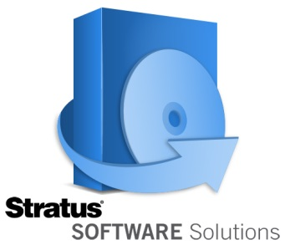
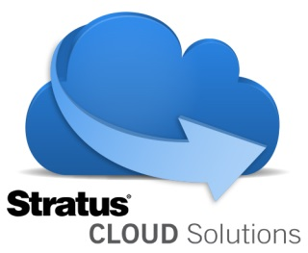
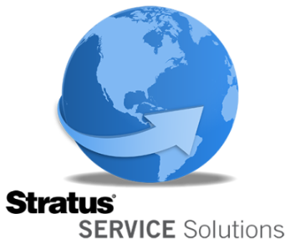
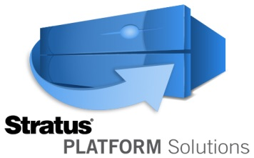
미션크리티컬 서비스 증대
보안제어
응급구조
금융시스템
생산 자동화.
정보시스템
의료기기
Notes:
Always-on has become a global requirement that touches every part of our lives.
In manufacturing environments – it’s about maintaining productivity and reducing waste
Retailers – need to ensure transaction processing systems are up and running to maintain sales targets
In Building Security – premises and individuals need to be protected from internal and external threats
In Public safety – lives are on the line
In Financial Services – the impact of system downtime is huge when you’re managing thousands of transactions per second
And in Healthcare accessibility of patient records and compliance is crucial

Slide 4


설립연도 1980년:
40개 이상의 FT 핵심특허 기술 보유
본사위치: 미국 Maynard, MA
시장내 위치:
17,000대 이상의 무중단 환경 운영중
Stratus Korea: 국내에서 20년 이상의 사업실적
4
Notes:
It’s no wonder that companies of all shapes and sizes, from Global Fortune 500 companies to SMBs have been relying on Stratus to keep some of their most critical business applications up and running for more than 30 years.
A company doesn’t last that long without creating value, using the newest technologies and being a trusted business partner. And our team of always-on professionals based at Stratus offices and services centers around the world are there every step of the way.

Slide 5

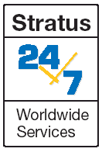

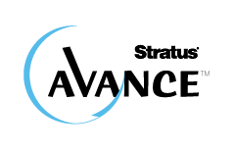
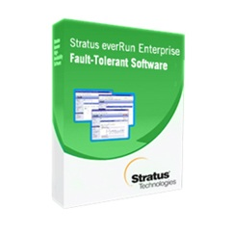






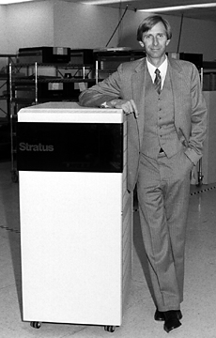





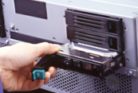
소개
Remote Service
Network
ftServer®
X86 server
1980-81
1982-83
1986
1988-90
1996-97
2001
2005-6
2007-8
2012
2014
Call-home
technology
Stratus FTX:
ft UNIX®
Acquires Marathon Technologies
Telecom soft-switch
1st fault-tolerant hardware (lockstep)
Hot-swap disks
V Series

Slide 6

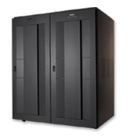


공급제품
소프트웨어 정의 고가용성
(SDA : Software Defined Availability)
H/W 기반
Easy, High Performance,
All-in-One
고가용성 솔루션
무중단 FT
하드웨어 기반의 FT 솔루션
X86 기반의 하드웨어 레벨의
클러스터링
No-Zero-Down Time의 FT
Notes:
With Stratus, preventing downtime has never been easier thanks to our flexible range solutions.
Our platform solutions provide end-to-end operational support with integrated hardware, software and services.
Our software solutions are designed to provide always-on capabilities to applications running in physical, virtualized or cloud environments.
All our solutions work with the major operating systems and hypervisors, allowing Stratus’ always-on technologies to work well within existing infrastructures.
Whether you are looking for an all-inclusive solution, or a software solution that works on your choice of standard industry servers, the end result is the same – Stratus will keep your applications running all the time with minimal intervention.

Slide 7

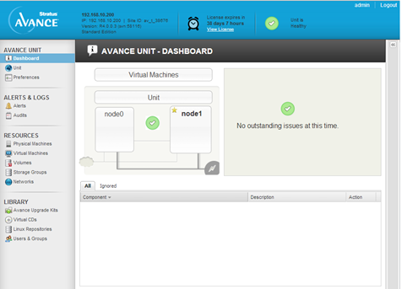
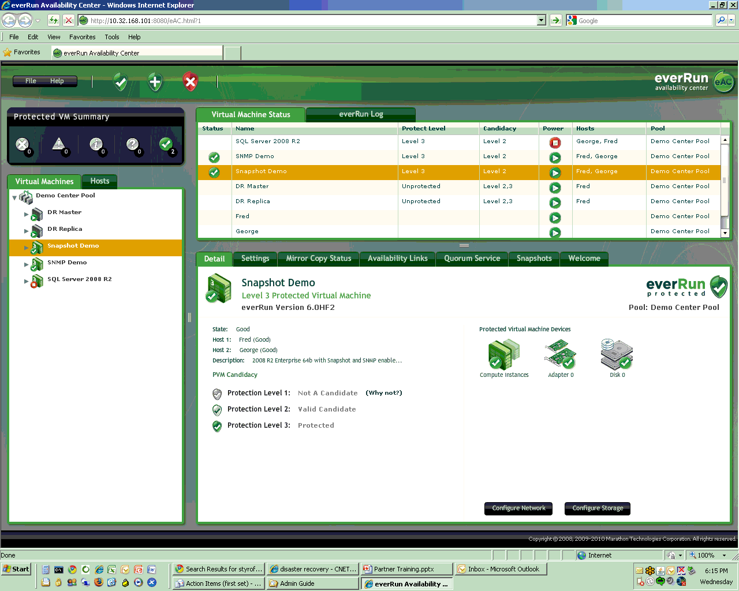


소프트웨어 정의 고가용성 솔루션
Easy Management | Specialist Management
Lower overhead | Configuration requires careful planning
Component Level FT | Full Systems FT

Slide 8
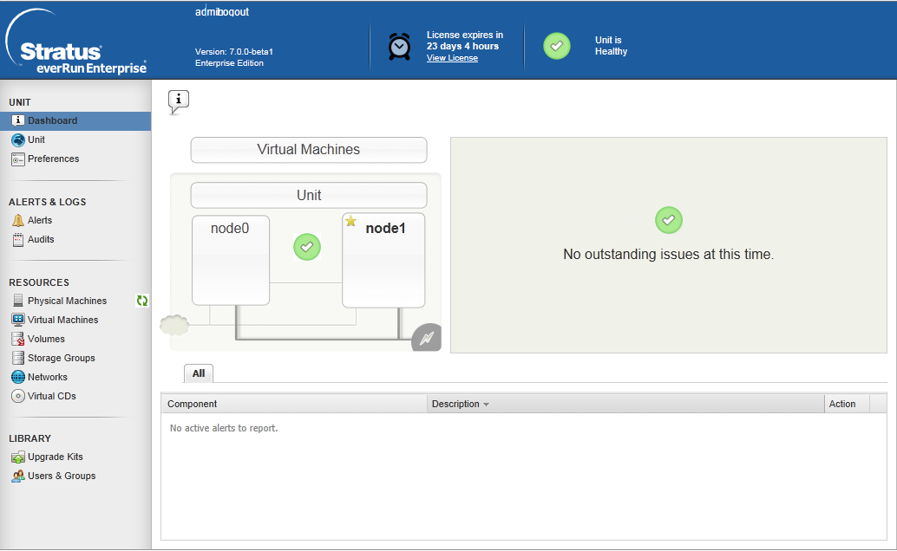
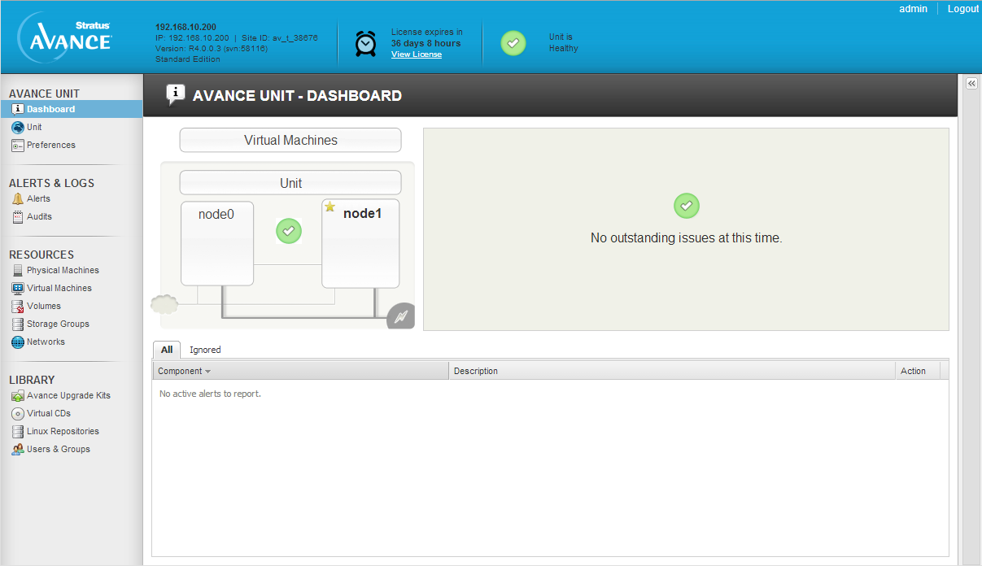
everRun Enterprise FT Software

Slide 9




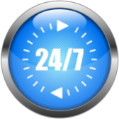
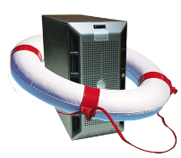










Stratus everRun® Enterprise Edition
유연성 편리성 신뢰성
업무연속성 및 데이터 정합성 보장
손쉬운 모니터링 및 관리
Availability
Engine
SplitSite
Disaster
Recovery*
Stratus One
View Console*
Watchdog
Service
Application
Monitoring*
무중단 업무지원
효율적인 자원 사용
근거리 지역 보호
업무 중단 없음
데이터 손실 없음
원격지 데이터
보호
빠른 서비스
재개
간편한 관리
중앙통합관리
모니터링 및
DR관리
시스템
모니터링 및
자동 경고
어플리케이션
모니터링 및
서비스 – 24/7 Support, Professional, Managed,
Education & Certification, Customer Service
* 2014년 Q3 지원

Slide 10
Stratus everRun® Enterprise Edition
Technical Overview
2014-04-03

Slide 11
everRun® Enterprise 개념
하나의 OS와 어플리케이션 이미지를 두대의 물리적 서버에서 동기화 운영
  단일 어플리케이션과 OS image
  두대의 물리적 서버를 RAID 1 mirror 처럼 구성
  각각 서버에서 CPU, 메모리, 디스크, 네트워크 동시 프로세스
  VM은 Single IP/MAC address
  HP, Dell, IBM등의 x86서버를 사용

Slide 12
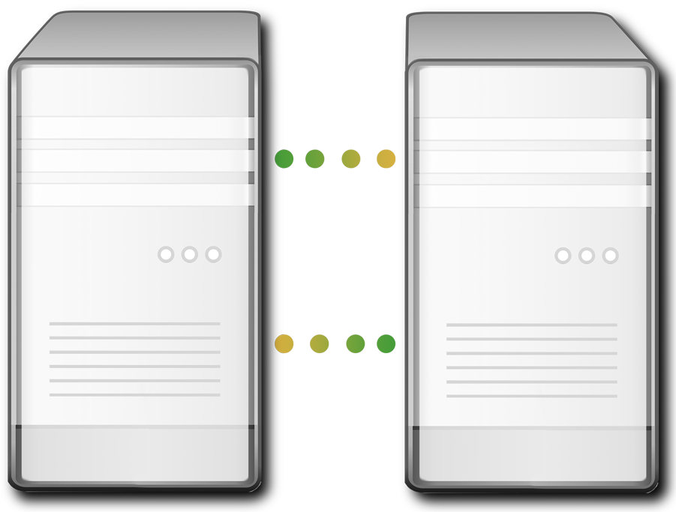

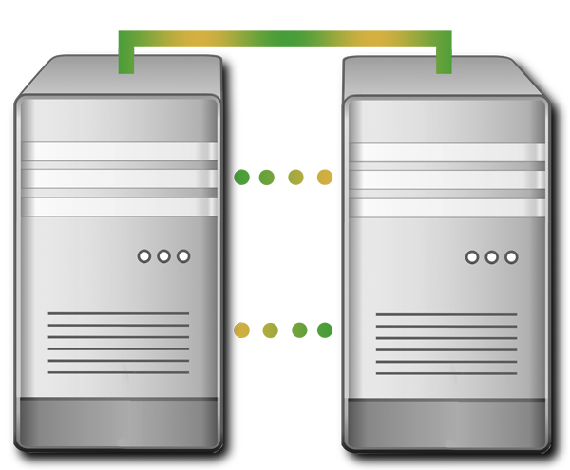


아키텍쳐
x86-Based Server
x86-Based Server
FT PROTECED
FT PROTECTED
Windows
Protected VM
App “A”
App “A”
Windows
Protected VM
Linux
Protected VM
App Set “B”
App Set “B”
Linux
Protected VM
=
PHYSICAL SERVER 1
PHYSICAL SERVER 2
Availability Engine
Availability Link
Availability Engine
Virtualzation
Hypervisor
Virtualization
Hypervisor
Network
Storage
Storage
Network
Business Network
Management Network
Stratus Copyright
12
Notes:
One application lives on two virtual machines. If one machine fails, the application continues to run on the other machine with no interruptions or data loss. If a component fails, it’s replaced with the healthy component from the 2nd system.
The I/O is automatically mirrored to the redundant server. Memory check-pointing ensures all in-flight transactions as well as data in memory and cache is preserved - without machine restarts.
We build an operating environment utilizing KVM on one server. Then, we add our Stratus Availability Extensions to create the fault tolerant environment. Once built, an availability link is used to duplicate and continuously communicate with the 2nd server.

Slide 13
설치 및 미러링
양쪽서버에 설치CD 를 통한 설치
가상머신의 보호를 위한 모든 요소 설치 완료
가용성 엔진 및 가상화를 위한 하이퍼바이저 설치
Avalability Link(HeartBeat)을 통한 실시간 동기화
외장스토리지 연결 불필요
x86-Based Server
x86-Based Server
Availability Extensions
Availability Link
Availability Extensions
Virtualization
Hypervisor
Virtualization
Hypervisor
Private Link
Private Links
Network
Storage
Storage
Network
Business Network
Management Network
Notes:
The everRun installation proceeds on either server. During the installation there are few choices for the components since everRun will utilize appropriate defaults as it encounters and configures components.

Slide 14
Network 구조
Node0
Node1
Availability Link (HeartBeat)
양쪽 노드간에 실시간 데이터 동기화 수행
Business Network
서비스가 사용하는 네트워크
Management Network
관리를 위한 사용
Private
Availability Link
Availability Extensions
Availability Extensions
Virtualization
Hypervisor
Virtualization
Hypervisor
Additional
Availability Link(s)
Network
Storage
Storage
Network
Business Network
Management Network
Stratus Technologies Confidential
14
Notes:
Communication between the two physical machines is done using one or more dedicated Availability Links (A-Links). These links are used for the high-speed transfer of data needed for the data synchronization and the automatic VM migration that everRun provides. Every everRun Enterprise will have one Private A-Link which handles management tasks and alert processing between servers.
Along with the A-Links, there are or more Business Networks assigned to Virtual Machines (VMs). Business Network adapters appear as virtual devices within the VMs and are accessed by applications and operating systems as they would a physical network adapter.
The Management Network is used for passing control and alert messages between the two logical “nodes” that make up the everRun Enterprise system. In the minimal everRun configuration, the Management Network shares the same network interface as the first Business Network which is defined during installation.

Slide 15

가상 머신
한번의 생성으로 양쪽에 동일한 OS및 어플리케이션이 구성
하나의 OS 및 app 이미지
선택적 Load-Balancing
각각의 VM은 특정 노드 또는 부하에 따른 로드밸런싱 선택적 적용 가능
선택적 가용성 레벨(3 types)
FT, HA and DR
Q3 CY14 제공
x86-Based Server
x86-Based Server
FT Protected
FT PROTECTED
Windows
Protected VM
App “A”
App “A”
Windows
Protected VM
Linux
Protected VM
App Set “B”
App Set “B”
Linux
Protected VM
HA PROTECTED
HA PROTECTED
Windows
App “C”
App “C”
Availability Extensions
Availability Extensions
Availability Link
Virtualization
Hypervisor
Virtualization
Hypervisor
Network
Storage
Storage
Network
Business Network
Management Network
Stratus Technologies Confidential
15
Notes:
Virtual Machines (VMs) are created and managed using the everRun Availability Console (eAC). As we mentioned earlier, installation of the guest OS and applications only needs to be done once, since everRun continuously mirrors the disk data between the Physical Machines.
Each VM can be assigned a default server or “node” where it will always run unless everRun detects a problem with that node. You might want to assign a default node for more control over the performance of a particular VM or set of VMs, or if you want them to run at the location you’ve designated as your primary site for security reasons.
You can also let everRun load-balance the system automatically to optimize the use of your computing resources.
As you see on this slide, we have two VMs running on this everRun system, each on a different node. Disk data is copied to the secondary node automatically by everRun so that its data can be used if the primary node disk fails. The disk mirroring is done synchronously, meaning that a write to a primary node disk is not considered completed until the same data has been written to the secondary node disk as well.
WJT – should this script mention why you might use a default node rather than load-balancing?
RAF – see added text

Slide 16

Checkpointing: The conceptual
App
Hold IO
Release IO
Hold IO
Release IO
OS
3
3
Active Server
VM Running
Checkpoint
VM Running
Checkpoint
VM Running
Time
App
Acknowledge
Acknowledge
1
1
OS
2
2
Standby Server
Send State
Send State
Receive
Checkpoint
Receive
Checkpoint
Time
Notes:
Checkpoint operations ensure that either server can continue operation should one fail.
To do this no I/O can leave the Active server until any modified memory data has been mirrored to the Standby server. Checkpoint operations occur constantly and in real-time.

Slide 17
Checkpointing: Failure Example
App
Hold IO
Release IO
Hold IO
Discard IO
Time
OS
3
Active Server
Failure
VM Running
Checkpoint
VM Running
Time
App
Acknowledge
1
OS
VM resumes operation from last received checkpoint
2
Standby Server
Send State
Receive
Checkpoint
VM Running
Time
Notes:
When failures occur the standby server will continue operation from the last checkpoint. Since the I/O was held on the Active side, it will only be released from the Standby side at the state of the last checkpoint.
This provides continuous availability with no data loss after the failure.

Slide 18
디스크 장애시 처리
VM1 (Primary)
VM2 (Secondary)
VM1 (Secondary)
VM2 (Primary)
Virtual Layer / Node0
Virtual Layer / Node1
Availability Engine
Availability Engine
Availability Engine
Availability Engine
Network Adapter(s)
Network Adapter(s)
Failure
Vdisk
Vdisks
Availability Links
Vdisk
Vdisks
Local Storage
Repository
Local Storage
Repository
Stratus Technologies Confidential
18
Notes:
Storage redundancy functions in much the same way. In this diagram we see two running VMs, each assigned to a different primary node. If there’s a failure of a local vDisk used by VM1, its Availability Extensions route the I/O request over the A-Links to the remote node where the AX on that node satisfies the request using the mirrored copy of the vDisk.
Failure of a single disk drive in a RAID-protected volume does not cause re-routing of disk data because the failure is transparent to everRun, though depending on the type of RAID protection it may result in degraded disk performance.
Because everRun mirrors its own boot data on a separate local volume if it exists, it will use the backup copy if the primary fails. Loss of both copies results in a node failure.
everRun Enterprise is unique among availability solutions in that it uses local disk storage and does not require an external SAN.

Slide 19
네트워크 장애시 처리
VM1 (Primary)
VM2 (Secondary)
VM1 (Secondary)
VM2 (Primary)
Virtual Layer / Node0
Virtual Layer / Node1
Availability Engine
Availability Engine
Availability Engine
Availability Engine
Network Adapter(s)
Network Adapter(s)
Failure
Network Adapter
Availability Links
Network Adapter
Default Active port for VM1
Standby port for VM2
Default Active port for VM2
Standby port for VM1
Business Network
Stratus Technologies Confidential
19
Notes:
Both HA and FT VMs include protection from network and storage failures. By using the A-Links between the nodes they can access the remote resource if the local resource is not available. This is all managed automatically by the Availability Extension code started along with each VM.
Each VM is assigned one or more local adapters on the primary system for connection to business networks, but if a local adapter fails its remote partner is accessed over A-Links. All IP and MAC addresses assigned to Business Networks are virtual, so that either physical adapter in a team can be used without losing Business Network connections whether the local or remote adapter is being used.

Slide 20













Companies Around the World Rely on Stratus
Notes:
But you don’t have to take our word for it. Our portfolio of customers speaks for itself.
This represents just a few of the companies who have come to rely on Stratus to keep their applications running in today’s always-on world

Slide 21
Q & A
2014-04-03

Slide 22
Extra Slides
2014-04-03

Slide 23
별첨
- 물리서버 및 가상서버 사양
- 화면 구성
- FT를 위한 CPU 리소스
- UI 구성

Slide 24
Physical Server Min/Max Requirements
Physical Device | Minimum | Maximum Tested | Architected | Notes
CPUs: Intel® Xeon® Processor E3 Intel Xeon Processor E3 v2 Intel Xeon Processor E5 Intel Xeon Processor E5 v2 | 1 | 2
Number CPU Sockets per Physical Machine | 1 | 2 | No Practical Limit
Physical Memory | 8 GB | 384 GB | No Practical Limit
Internal Disk Count per Physical Machine | 2 | 24 | No Practical Limit
Total Disk Capacity | 36 GB | 9.4 TB | No Limit
Logical Volume Size (everRun Boot Volumes) |  | 5 TB | No Limit
Logical Data Volume Size (Non-boot Volumes) |  | 5 TB | No Limit
Management ENET Ports | 1 | 1 | 1 | 1 per system required.
Sync Link ENET Ports | 1 on each PM | 8 on each PM |  | 10 GB Ethernet NICS 2 recommended.
Business ENET Ports | 1 | 20 |  | Can be shared with Management link.
Notes:
Here are some of the server minimum and maximum configuration values for this version of everRun Enterprise. You’ll note that some of the upper limits reflect what has been tested and not hard limits. Use caution if you exceed any of these limits.
(Need min/max disk capacity)

Slide 25
VM Maximum Configurations
Item | Maximum
Max. VCPUs per FT VM | 8
Max. VCPUs per HA VM | 16
Max. Memory per FT VM | 256 GB
Max. Memory per HA VM | 256 GB
Max. Availability Links per VM | 2
Max. Virtual Networks per VM | 20
Max. Storage Volumes per VM | 12
Max. Volume Size | Per operating system restrictions
Notes:
This chart shows the current VM configuration limits and a comparison to Stratus Avance and everRun MX in case you’re currently using one of those products and considering the advantages of an upgrade to everRun Enterprise.

Slide 26
Guest Operating Systems Supported
Vendor | Versions
Microsoft Windows Desktop | Windows 7 Windows 8 Windows 8.1
Microsoft Windows Server: | Server 2008, 32/64 bit Server 2008 R2, 64 bit Small Bus Server, 2011, 64 bit Server 2012, 64 bit Server 2012 R2, 64 bit
RedHat Linux | RHEL 6.4, 64 bit
CentOS Linux | CentOS 6.4, 64 bit
Ubuntu 64 Bit | Latest and next-to-last release
Stratus Technologies Confidential
26
Notes:
This is the list of Windows guest operating systems supported as of everRun Enterprise version 7.1

Slide 27
FT를 위한 리소스 CPU
엔진 사용 기본 vCPU
  2개가 기본이며, VM 개수 증가시 4 vCPU 권고
엔진 포함한 경우 CPU 개수 산정
  2 x number_of_vms + sum (vm_vcpus) + 2
    예) 2개의 가상머신이 각각 6개 4개의 vCPU 사용시
    2 x 2 + (6 + 4) + 2 = 16 vCPUs
Notes:
You’ll need to take into account some everRun Enterprise overhead when sizing hardware. You can view and change some of the settings using the “System Resources” preferences screen in the eAC. For systems running fewer than 20 VMs you should allocate 2 vCPUs and 2GB of memory to everRun, which are the default settings. For systems running more that 20 VMs, we recommend allocating 4 vCPUs and 4GB of memory. There are also vCPU resources and memory allocated for the Availability Extension (AX) processing associated with each VM. The resources used depend on whether the user VM is configured as FT or HA. These resources are allocated as needed while the VM runs. The actual amount of AX processing overhead depends on the activity of the running VMs.
Here’s a formula you can use to get a “worst case” estimate of the AX CPU resources required for your FT VMs.
AX CPU overhead for FT VMs is 2 x number_of_vms + sum(vm_vcpus)
So for example if you are running two FT VMs, one with 2 vCPUs and the other with 4 vCPUs the calculation would look like this: (on whiteboard???)
AX CPU overhead for FT VMs = (2 x 2) + sum(2 + 4) = 10 CPUs. Remember this is worst case with all vCPUs in all VMs fully loaded.
The AX CPU overhead calculation for HA VMs is still being developed, but it should be less than FT since there is no memory checkpointing to be done. For now, use the same calculation as for FT VMs.
In addition to knowing the peak processor usage of each VM, it’s important to know when those peaks occur. If the peak load for a particular VM occurs at a fixed time and duration every day and it’s idle the rest of the time, you may not need as many physical processors in the system unless other VMs are also very active during that same period. On the other hand, if all VMs run at a constant load 24 hours a day you’ll need to size the servers with that in mind.
If one or more VMs have critical processing or SLA requirements, you may want to dedicate hardware exclusively for their use. For example, you might add a network adapter to each server as a business link which is allocated only to a single VM. While everRun Enterprise allows over-committing of CPU resources, you may want to take a more conservative approach and size for a one-to-one relationship between virtual and physical CPU requirements.

Slide 28
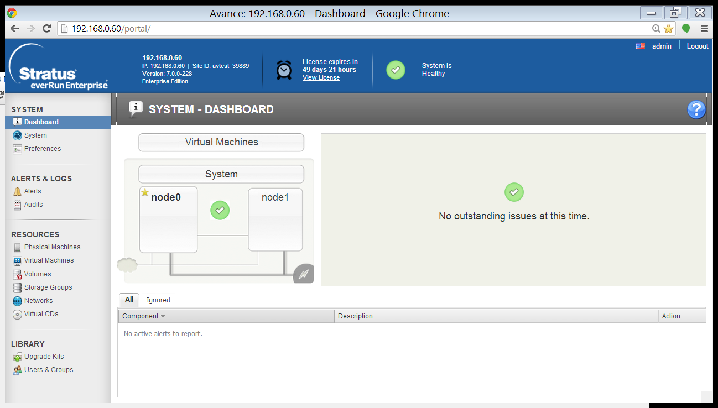
Dashboard
Notes:
This is the first screen you see after login – the Dashboard. It shows a summary of your everRun Enterprise system’s health. If there were one or more problems, you’d see them indicated here in graphical form and in the alert box below. The grayed-out cloud and lightning bolt icons would be active if there were a network or power problem respectively.
You’ll also notice the star next to node0 indicating that it’s currently the primary node of this system.
In the banner at the top of the page you’ll see useful information like the IP address of the eAC, this system’s license ID, the version of everRun Enterprise software you’re running, your time to expiration if you’re using a trial license and the language being used by the eAC and help files indicated by a flag. There’s also a logout function which you should remember to use for security purposes when you’ve finished your session. If you forget to log out, everRun will do if for you after a fixed period of inactivity.
For readability, we’ll be zooming in on the screenshots that follow, so keep in mind that there may be portions of the interface that are chopped off.

Slide 29
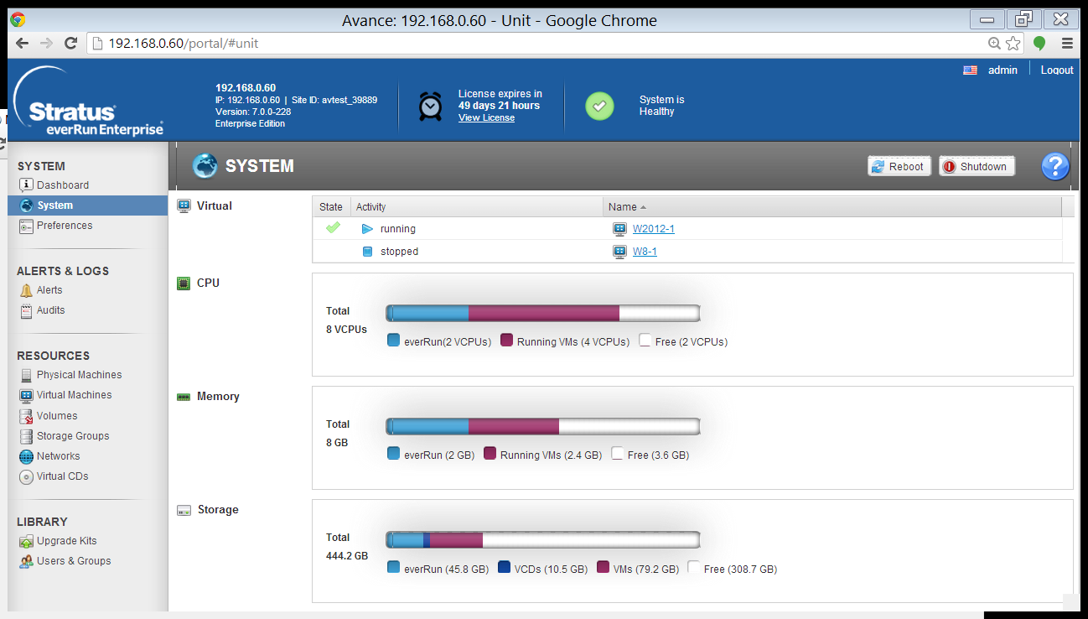
Viewing Configuration: Usage Profile
Notes:
Moving down the navigation pane on the left, the next screen you see shows the System status. This page displays all virtual machines and whether they’re running or stopped, along with the CPU, memory and disk storage used and available. The blue area at the left of each usage bar shows the amount of that resources being used by everRun, the red area is the usage by all running VMs, and the white area shows unused resources.
You’ll also notice a Reboot and Shutdown button for the entire system. Rebooting will perform a complete restart of each physical server after migrating any running VMs, then migrate them back again before restarting the remaining server. A shutdown is just that – a complete shutdown of both servers which will also terminate any running VMs.
You’ll see the blue circle and question mark on every page. That’s the context-sensitive online help feature of everRun which will display the appropriate help information for whichever page you’re on. For example, if you click the one on this page…

Slide 30
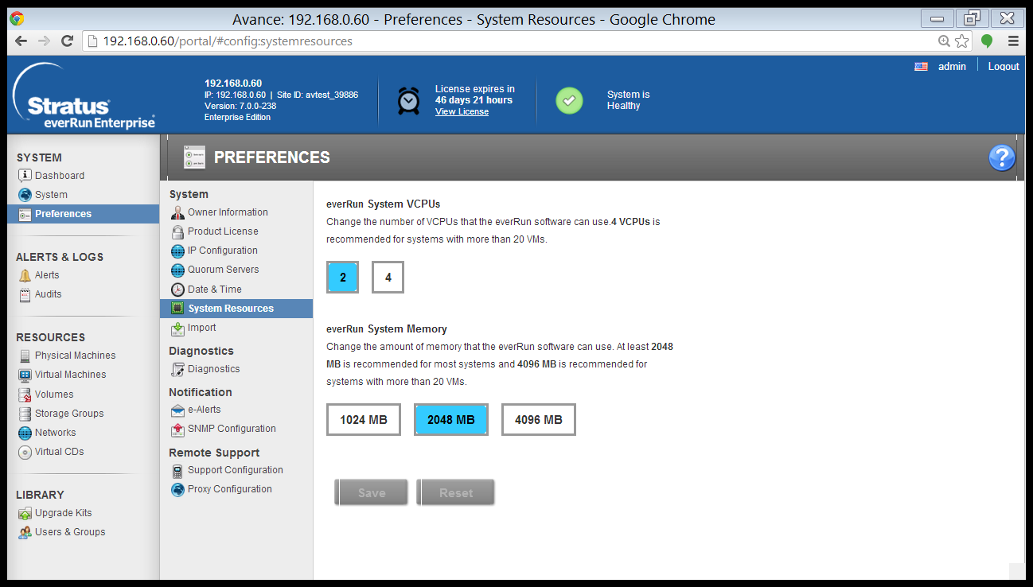
everRun Enterprise System Resources
Notes:
There is some vCPU and memory overhead in an everRun protected environment. Use the default settings of 2 vCPUs and 2048 MB of memory for the everRun software layer unless planning to run more than 20 VMs concurrently. In that case, increase the settings to 4 vCPUs and 4096 MB.

Slide 31
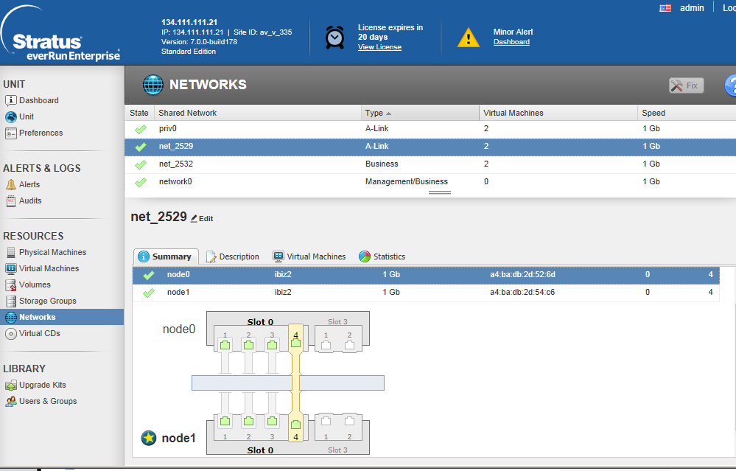
Viewing Configuration: Network Adapters
Notes:
This view shows how the network adapters are utilized and how they are configured between the nodes. Network adapter usage can also be easily reconfigured here. As an example an adapter’s role could be changed to be an additional A-Link or changed from an A-Link to Business adapter.

Slide 32
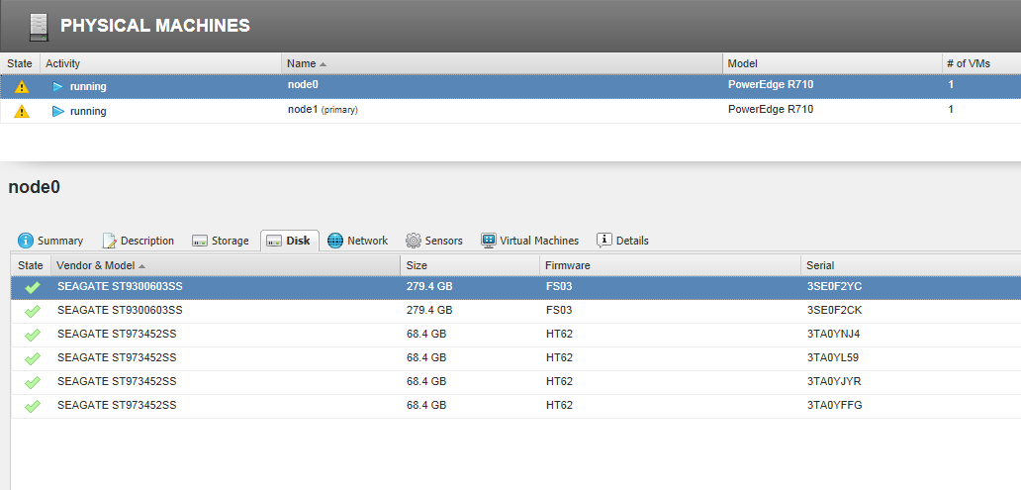
Viewing Configuration: Physical Storage
Notes:
For each Physical Machine the storage detail associated with that node can be displayed.

Slide 33
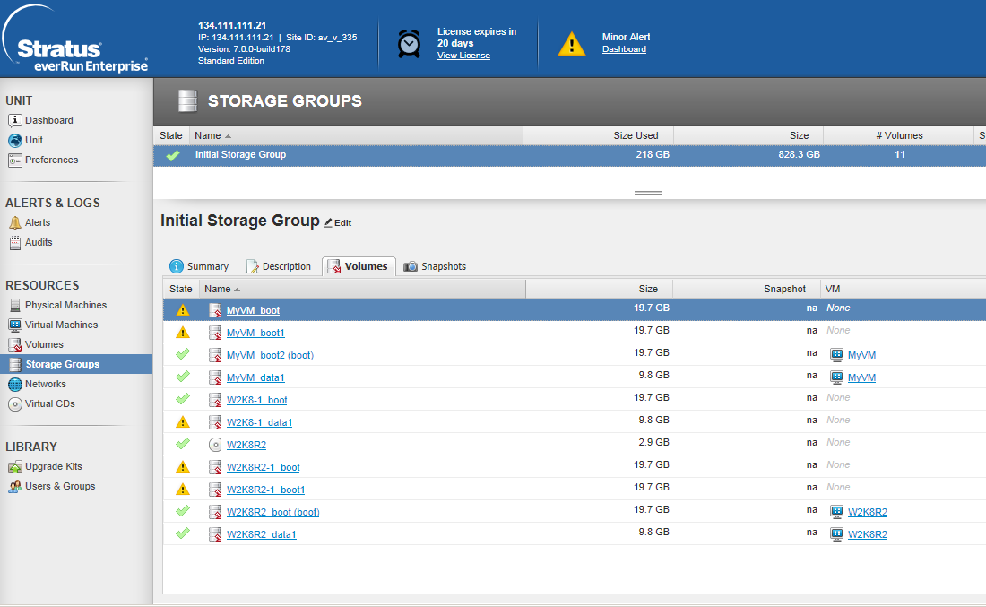
Viewing Storage Group Allocation
Notes:
Storage Groups can be listed by PVM and VCD volume allocation. This view shows the sizes and state of each Volume

Slide 34
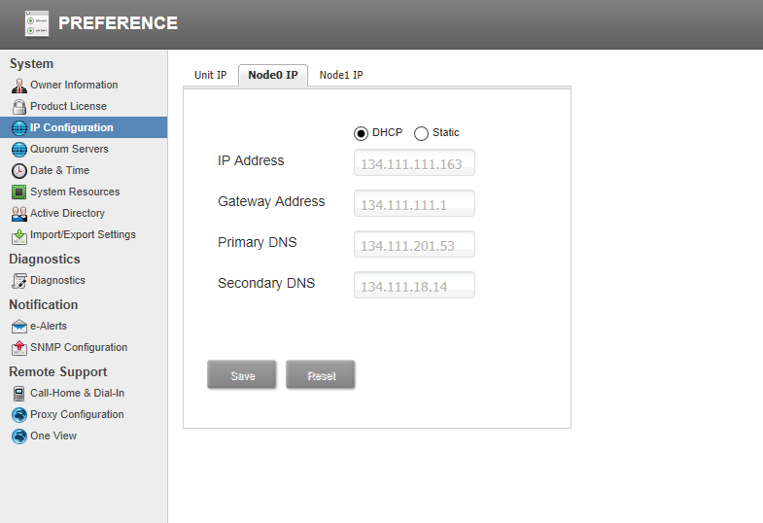
System IP Address Preferences
Notes:
Each node’s IP address and the everRun System’s IP address can be changed with this screen. This is particularly helpful when staging a configuration in one place and deploying it into a different (production) network.

Slide 35
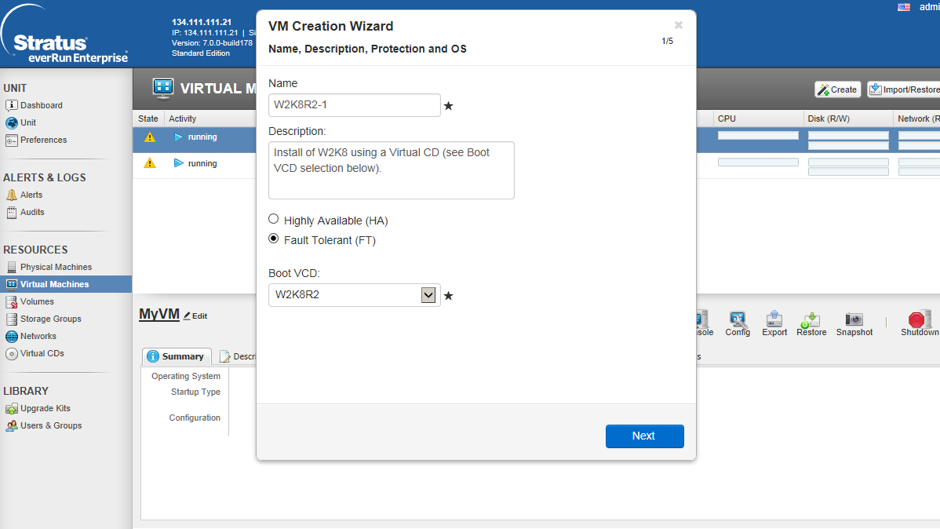
Create a Protected VM
Notes:
Creating a Protected VM is straightforward using the everRun Protection Wizard. First choose the ‘Create’ button to bring up the Wizard.

Slide 36
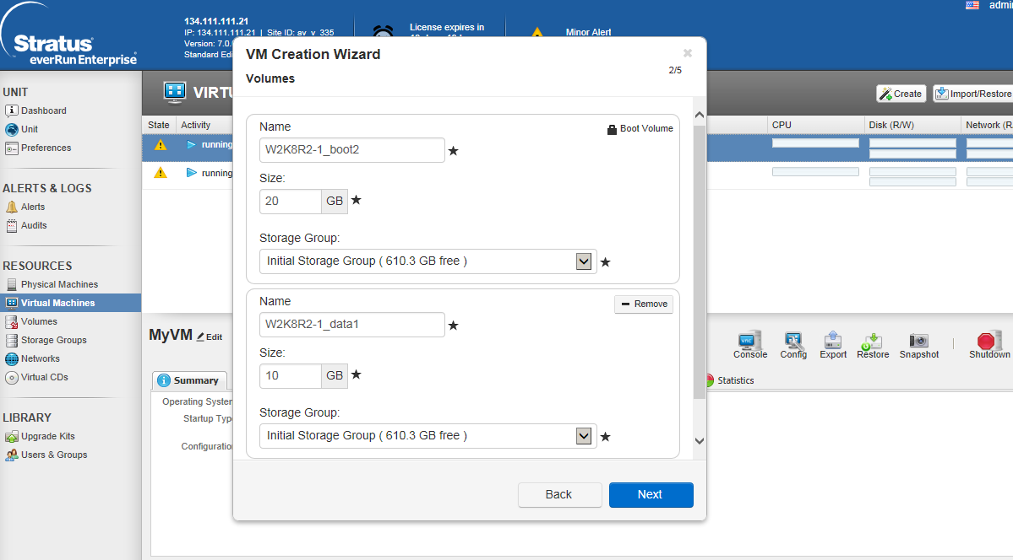
Create a PVM: Select Storage
Notes:
Next select one or more storage volumes for this VM.

Slide 37
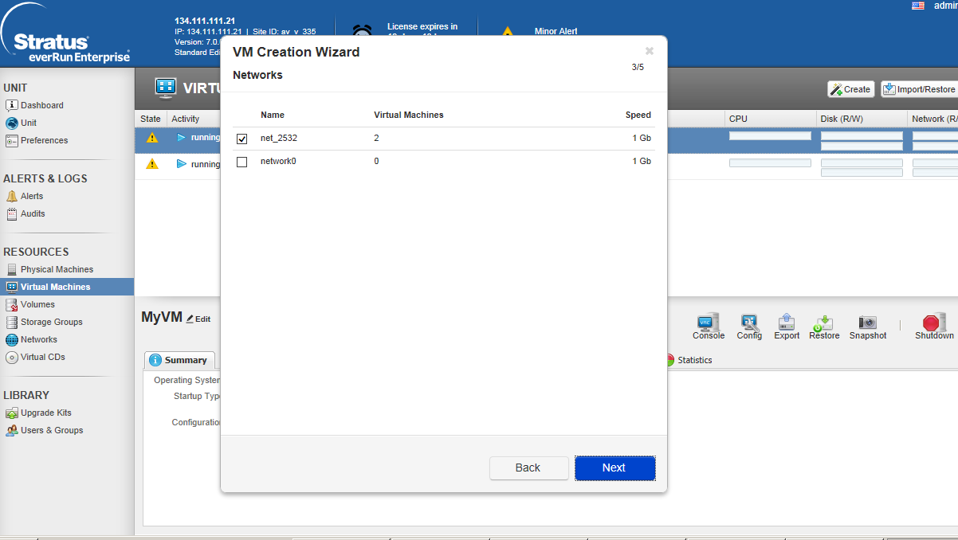
Create a PVM: Select Business Network
Notes:
Next select one or more business networks for this VM.

Slide 38
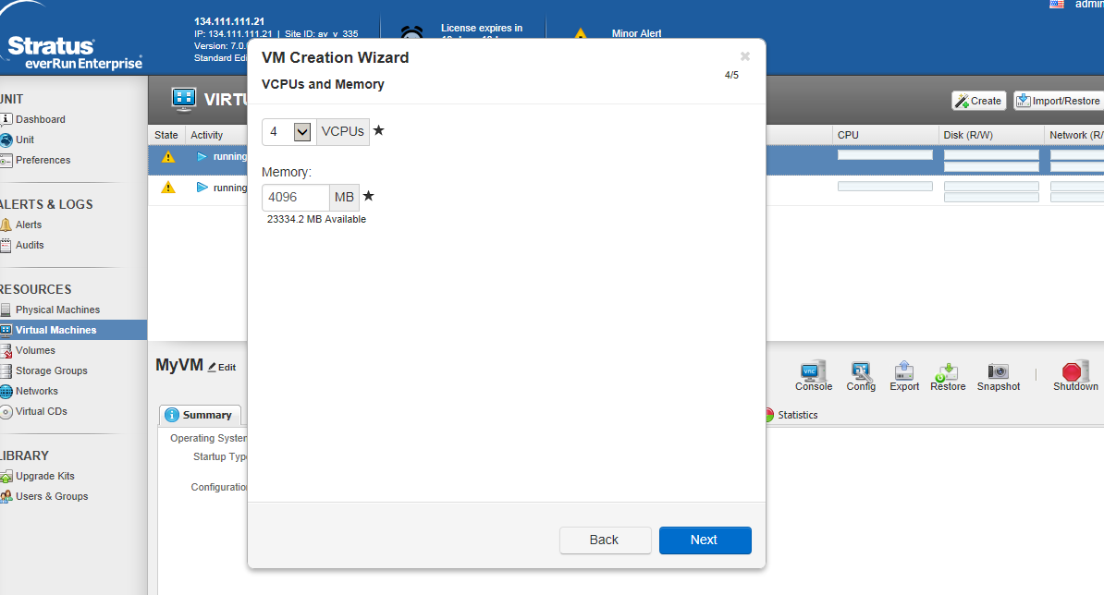
Create a PVM: Select vCPUs and Memory
Notes:
And finally, select the amount of memory and CPUs (cores) that this VM requires.

Slide 39

Create a PVM: Summary
Notes:
The summary page is shown and selecting Finish will launch the console window (if checked) to complete the Operating System configuration setup.

Slide 40
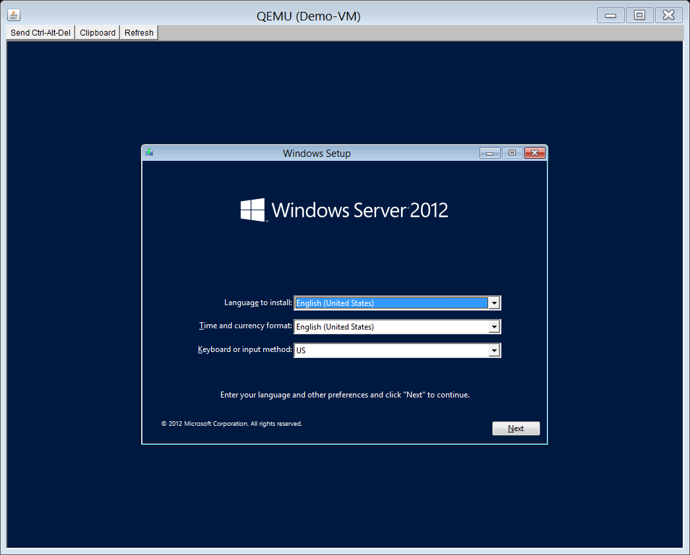
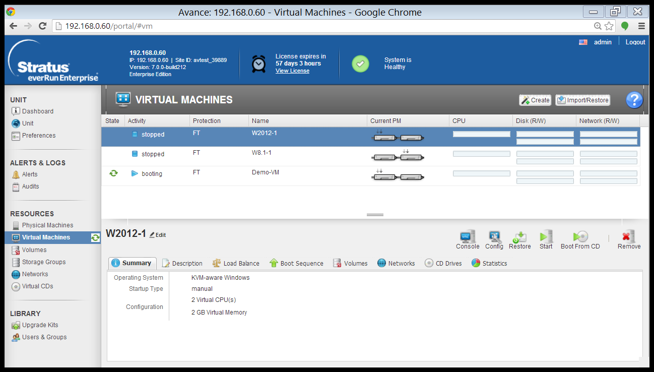
VM OS Installation Screen
Notes:
The console window will stop with the first screen requiring user input. You can now proceed exactly as you would with a physical installation.

Slide 41
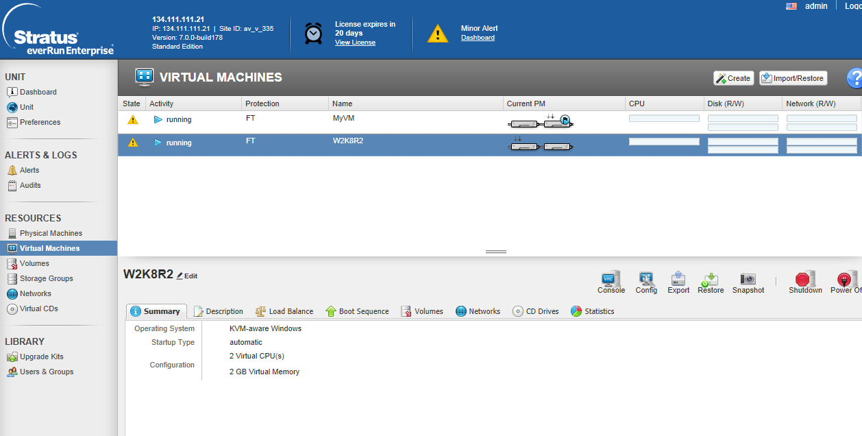
PVM Installed
Notes:
Once the PVM is installed it is show in the Virtual Machine window along with its associated components and which node is currently primary for that PVM. From this screen the PVM can also be reconfigured, exported or shutdown.

Slide 42
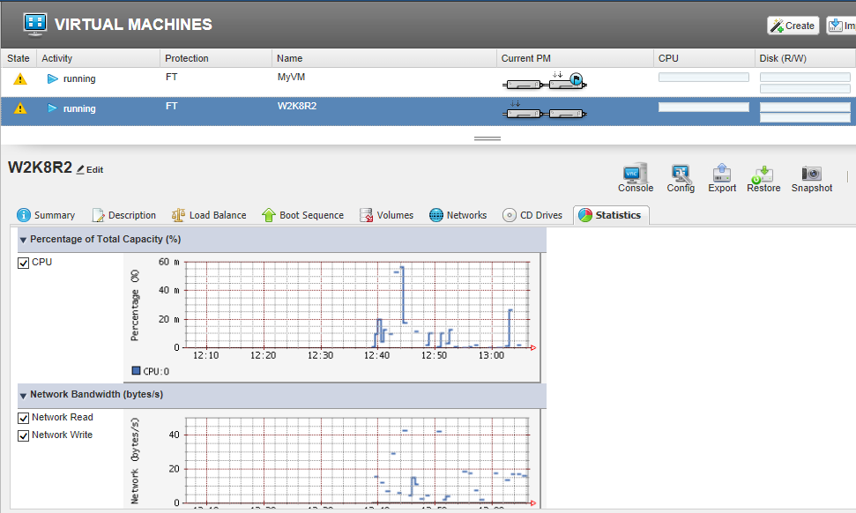
PVM (Real-time) Running Statistics
vCPU Utilization
Network (Read/Write) Utilization
Notes:
Statistics can also be viewed for each PVM by focusing on a PVM and then choosing the Statistics tab.

Slide 43




Stratus everRun Enterprise
No downtime, revenue, or transaction loss – locally, cross campus
Meet business continuity goals and remain compliant
Trusted
Click & go installation
Integrated disaster recovery
Centralized tools for server, VM, and DR
Comprehensive monitoring & notification
Easy
No changes to applications
Utilize existing skill sets and industry standard x86 hardware
Makes multi-core Windows & Linux apps fault-tolerant
Flexible
High availability features: Redundant, hot swappable components
Predictive Failure Analysis, Light Path Diagnostics, Feature on Demand
Reliable
Notes:
Unlike other solutions, everRun Enterprise is preventative, not reactive. It prevents downtime from occurring, instead of merely recovering from it. And that difference has a big impact on your bottom line, top line, customer satisfaction goals and efficiency rates. Disaster recovery is tightly integrated, so no matter what happens, you’re protected.
everRun Enterprise is quick and easy to install. Servers, virtual machines and disaster recovery is managed from one centralized location with a keystroke on your keyboard.
everRun Enterprise can run both single and multi-threaded Windows and Linux applications fault tolerantly.
And you don’t need specialized hardware or IT personnel to do it – they can use what they have because it runs on trusted IBM x86 servers and is simple to install and manage.

Slide 44


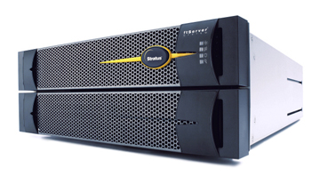
Platform Solution – Stratus ftServer
2014-04-03

Slide 45
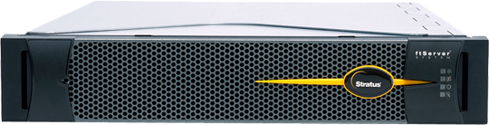
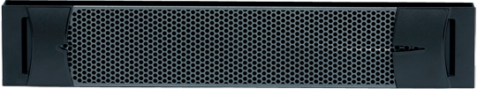
ftServer의 구조
이중화 하드웨어 컴포넌트
PCI
Automated Uptime
Layer
장애감지 및 격리
CPU
Chipset
Embedded I/O
Memory
Multi-path I/O
Lockstepped CPUs
PCI
Automated Uptime
Layer
장애감지 및 격리
CPU
Chipset
Embedded I/O
Memory
치명적인 장애요소 감지제거
어플리케이션 수정 불필요
이중화장비지만 싱글이미지 제공
장애복구 시간 = “0”
Notes:
Employing the core uptime layer on Stratus hardware take uptime assurance to an entirely different, higher level. Because we build the server expressly to be fault-tolerant – unlike regular commodity products -- the software and hardware are much more closely integrated. To the operating system and application, it appears as a single x86 server. It operates and is managed as a single server, so much so that only one software license is required for all be a very few applications. Beyond that, the middleware is actively engaged with the proactive monitoring technology, seeing the activity of all systems and components at very discreet levels, to such a degree that it predicts and prevents causes of downtime, even transient errors. For all intents and purposes, Level 1 product support is in the server itself. A component failure or outage is shielded from the application and processing continues using the online back-up already operating in the server. No failover, downtime, data loss, or performance degradation. The user has to do nothing.
45

Slide 46
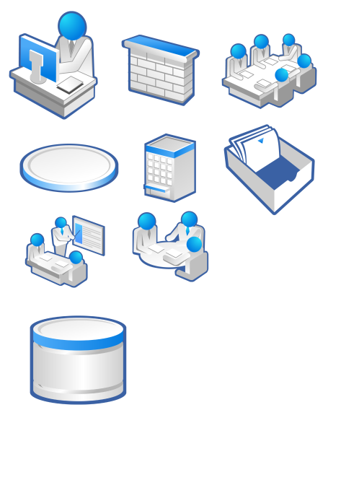

Lockstep 기술
DMR(이중화 모듈 복구) Lockstep 디자인
이중화된 CPU, 메모리, chipset, 디스크, I/O 컴포넌트
내장된 Lockstep ASIC에 의한 동기화 기술
디스크 이중화, HBA 멀티패스 I/O, NIC 이중화로 장애발생시 자동 스위칭
산업표준 컴포넌트
장애 감지
산업표준 컴포넌트
Ethernet
PCI
메모리
CPU
장애감지
격리
장애감지
칩셋
NIC 이중화
미러링
동시
프로세싱
CPU Lockstep
PCI
메모리
CPU
장애감지
격리
장애감지
칩셋
Ethernet
내장된
ASIC
멀티패스 I/O
Lockstep 기술
Notes:
DMR components:
Lockstep : CPU, memory and chipset
Disk: Software mirror
LAN: Cheaming (automatic failover without session disconnect.)

Slide 47
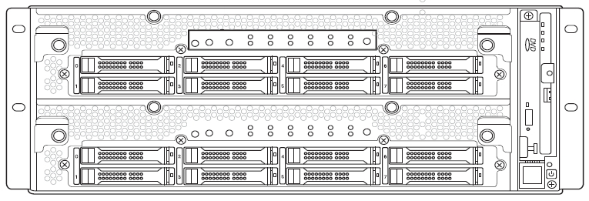
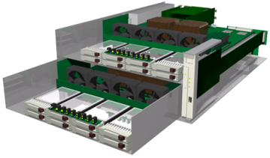
장애발생시에도 시스템 무중단
CPU-I/O enclosure＃1
HDD 모듈
CPU-I/O enclousre＃1
CPU
CPU
LAN
ASIC
SCSI
동시
프로세싱
메모리
미러링
메모리
ASIC
SCSI
CPU-I/O enclousre＃2
HDD 모듈
CPU
CPU
LAN
CPU-I/O enclosure＃2
내장된 CPU, 메모리, I/O등의 동시 프로세싱, 장애 검출등의 ft기능을 1개의 ASIC 칩으로 실현
서버로서의 처리 성능을 떨어뜨리지 않고 높은 가용성을 제공.
CPU, 메모리등의 성능저하없이 이중화 제어

Slide 48

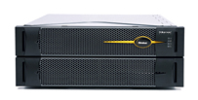

시스템 제원
 | 2700 Low-end system | 4700 Mid-tier system | 6400 High-end system
주의 : 기술된 모든 컴포넌트 수량은 논리적인 수량이며, 물리적인 수량은 논리적인 수량의 2배임
프로세서 | 1-socket | 2-socket | 2-socket
CPU QPI 성능 | Quad-core 1.8 GHz 6.4 GT/s QPI | Quad-core 1.8 GHz 6.4 GT/s QPI | Octa-core 2.6 GHz 8.0 GT/s QPI
CPU 캐쉬 | 10 MB Shared | 10 MB Shared | 20 MB Shared
메모리 Bandwidth | 34.1 GB/s | 68.2 GB/s | 85.3 GB/s
메모리 슬롯 | 8 DIMM Slots | 16 DIMM Slots | 16 DIMM Slots
시스템 메모리 | 32 GB | 256 GB | 256 GB
기본내장 컴포넌트 | SAS, 2x ENET (10/100/1000) , 3x USB2.0 (후면부), 1x USB2.0 (전면부), 2x COMM, VGA, BMC, DVD R/W (전면부)
내장된 PCI 슬롯 | 2 x PCIe
확장 PCI 슬롯 | N/A | 2 x PCIe Gen 2 | 2 x PCIe Gen 2
RAID 1 Disk (Internal) | 8 x 2.5” SAS Disks
사이즈 | 4U Rack | 4U Rack | 4U Rack
Notes:
48

Slide 49
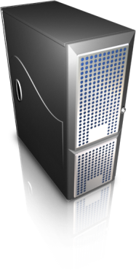

The Stratus Portfolio

Slide 50


Software Solution
Platform Solution
Multi-Core CPU를 지원하는 FT 솔루션
유연성 및 신뢰성 보장
표준 86 서버 환경 지원
(Dell, HP, IBM, Intel,..)
Windows, Linux 지원
어플리케이션 수정 없는
100% 호환성 보장
재해대비를 위한 Split-site 구성 지원
하드웨어 기반의 FT솔루션 탑재
박스 개봉후 추가 설치 없이 사용
99.999% 신뢰성 제공
어플리케이션 수정 없는
100% 호환성 보장
Windows, Linux, Vmware 지원

Slide 51
운영방식 | Software FT | Hardware FT
하드웨어 호환성 | 2 x Industry standard x86 server | 1 x Stratus ftServer
물리적 이중화 | Yes | Yes
단위(disk, nw, memory등) 장애 감지 | Yes | Yes
단위 장애 레포팅 | Yes | Yes
스트라투스 자동 Call-home | Yes | Yes
SNMP 경고 | Yes | Yes
Email 알림 | Yes | Yes
Split site를 통한 재해대비 | Yes | With 3rd party solutions
Load-balancing | Yes | With 3rd party solutions
지원 스토리지 | Internal RAID, iSCSI | FC-SAN, iSCSI
지원 OS | Windows, Linux | Windows, Linux, VMware
가상화지원 | Embed | Required VMWare
국내부품공급 | WW hardware vender | Stratus

